Slide 1
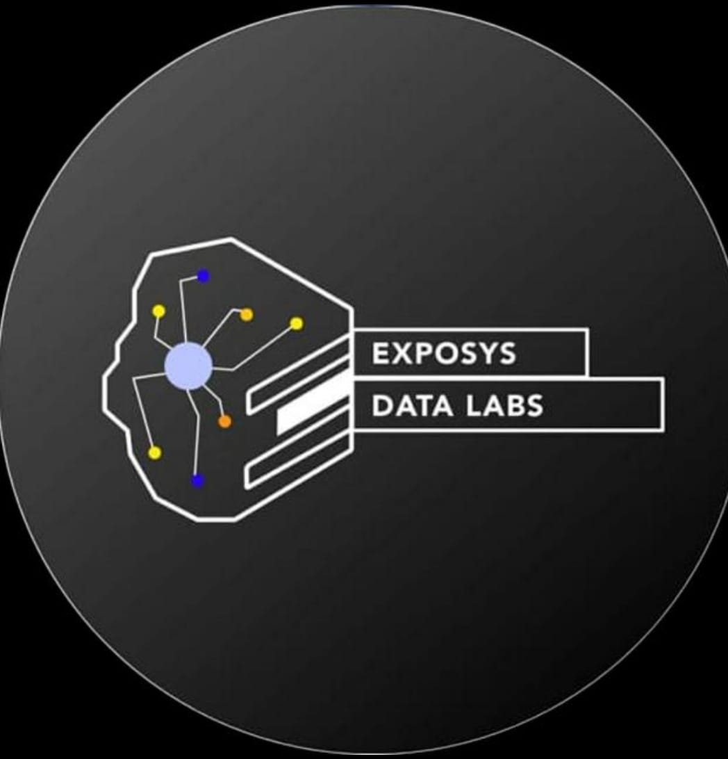
A
Data Science Project
on
Diabetes Prediction
EXPOSYS DATA LABS
Supervised by:
Vishnuvardhan Y Mentor @Exposys data lab
Presented by:
Aparna Raha
5TH Semester

Slide 2
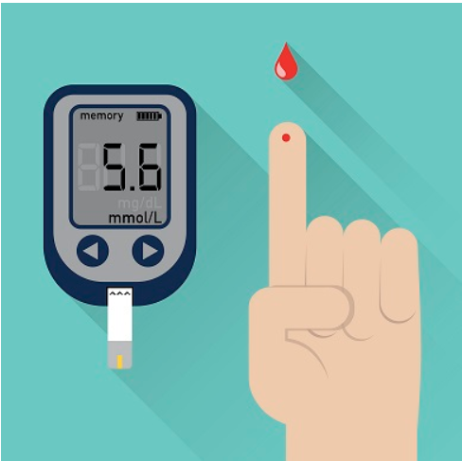
CONTENT
2
Abstract
Introduction
Origin of the problem
Motivation
Problem statement
Architecture
Technology & Methodology
Model Building
Conclusions
References

Slide 3

abstract
Diabetes is an illness caused to every human kind . Due to high glucose level in a human body. And diabetes should not be ignored if it is untreated then diabetes may cause some major issues in a person like heart related problems , kidney problem , blood pressure and eye damage and it can also affects other organs of human body . data science focuses on the development of computer system that can access data and use it to find hidden insights without being explicitly programmed where to look .

Slide 4
INTRODUCTION
Diabetes is a common chronic disease and poses a great threat to human health. The characteristic of diabetes is that the blood glucose is higher than the normal level , which is caused by defective insulin secretion or its impaired biological effects, or both . It can lead to chronic damage and dysfunction of various tissues, especially eyes, kidneys, heart, blood vessels and nerves . Diabetes can be divided into two categories :- type 1 diabetes Patients with type 1 diabetes are normally younger , mostly less than 30 years old . The typical clinical symptoms ae increased thirst and frequent urination, high blood glucose levels .This type of diabetes cannot be cured effectively with oral medication alone and the patients are required insulin therapy. Type 2 diabetes occurs more commonly in middle aged and elderly people which is often associated with the occurrence of obesity, hypertension, dyslipidemia, arterioscles, and other disease. Data science can help people make a preliminary judgement about diabetes mellitius according to their daily physical examination data and it can serve as a reference for doctor .

Slide 5
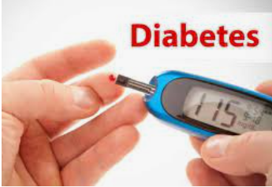
Origin of the problem
Diabetes has been affecting lives for thousands of years. An ailment suspected to be diabetes was recognized by the Egyptians in manuscripts dating to approximately 1550 B.C.
According to one study Trusted Source, ancient Indians (circa 400–500 A.D.) were well aware of the condition, and had even identified two types of the condition. They tested for diabetes — which they called “honey urine” — by determining if ants were attracted to a person’s urine.

Slide 6
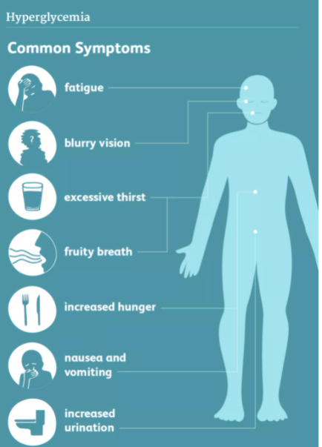
Overview of diabetes
Symptoms of diabetes include:
Increased thirst.
Weak, tired feeling.
Blurred vision.
Numbness or tingling in the hands or feet.
Slow-healing sores or cuts.
Unplanned weight loss.
Frequent urination.
Frequent unexplained infections.
Dry mouth.
Complications of diabetes:
Eye damage
Foot damage
Skin infections.
Erectile dysfunction.
Hearing loss.
Depression.
Dementia.
Dental problems.
Nerve Damage.

Slide 7
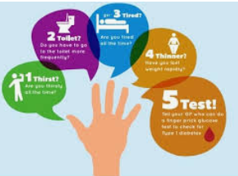
motivation
By seeing present scenario of diabetes, I decided to grow my data science skills by engaging in diabetes prediction. I did this not only to learn but also to appreciate the essence of data science in solving some of the problems that plague humanity .
Today the field of data science improved the classification problem and when it comes to diabetes disease it is truly a wonderful field to provocate knowledge in the field of data science.

Slide 8
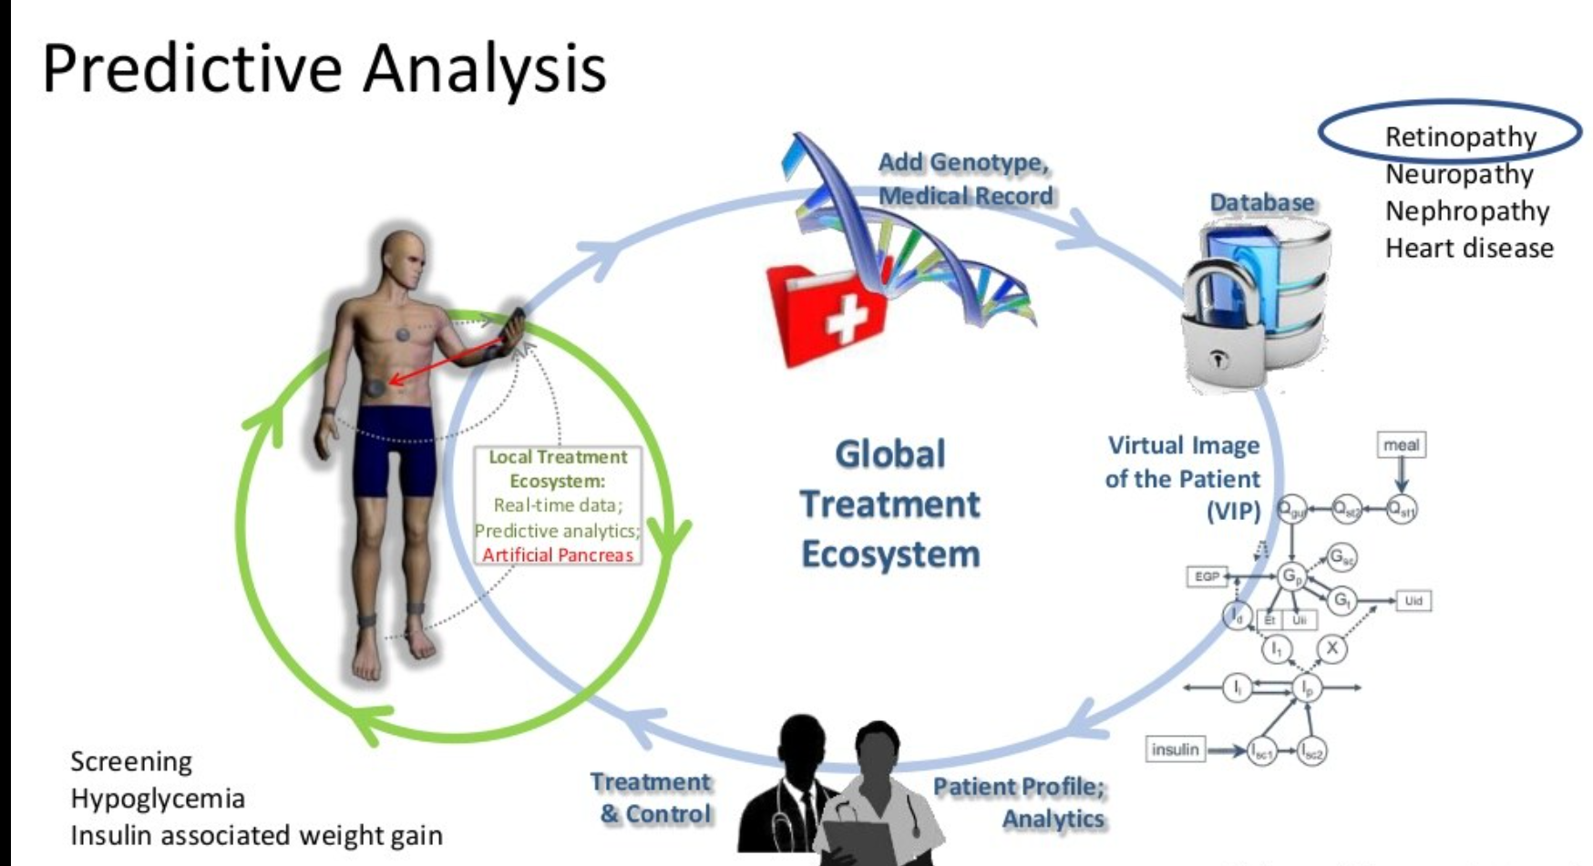
Problem statement
Prepare the data set using several method to train the model.
Build a model which can give high accuracy of predicting the disease.

Slide 9
Architecture/process flow
Data Exploratio
Pre-processing
Training data
Model selection
XGBoost
Logistic regression
SVM
Classifier
Decision tree
Random forest
Final Classification model
Yes
No

Slide 10



Technology and methodolgy
Python Language used for programing.
Python libraries such as pandas, numpy, sicit learn and its various libraries.
Visual Studio Code, Jupyter notebook for implementation purpose.

Slide 11
Preparation of datAset
We got this dataset from Kaggle site. In this dataset , predictor variable includes the no. of pregnancies the patient has had , their BMI , insulin level, age, and so on . The dataset has 9 columns as shown below.
Pregnancies – no. of times pregnant
Glucose – plasma glucose concentration a 2 hours in an oral glucose tolerance test.
Blood pressure - diastolic blood pressure (mm hg)
Skin thickness – triceps skinfold thickness(mm)
Insulin – 2 hour serum insulin in (mu U/ml)
BMI – body mass index (weight in kg/ (height in m)^2)
Diabitesepedigreefunction – diabetes pedigree function
Age – age (years)
Outcome- class variable (0 or 1)268 of 768 are 1, the other are 0

Slide 12
Methodology
By importing the dataset, and conducting exploratory data analysis to get insights and understanding on how the dataset build the model . Then using decision tress, random forests, and xgboost.
5 steps of data science , provides the following general framework of steps in supervised data science.
Data Exploration
Univariate Analysis
Bivariate Analysis
Model building
Prediction

Slide 13
Importing libraries
pandas
Numpy
classifier
sklearn
Matplotlib
Pandas
Numpy
Matplotlib
Scipy
Seaborn
Sklearn feature Extraction
Sklearn Linear Model
Sklearn Ensemble Method
Sklearn Metrics

Slide 14
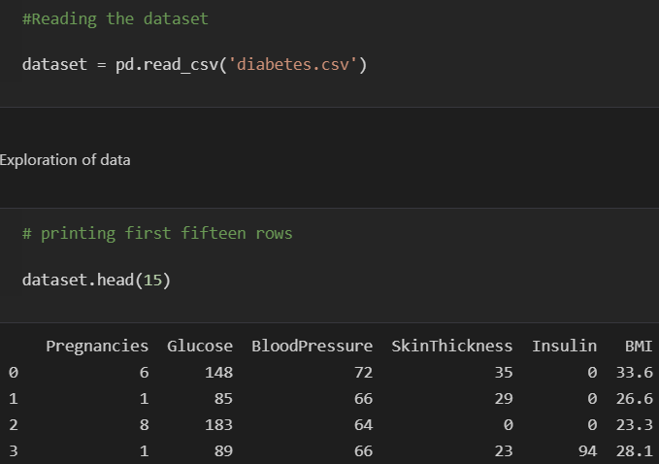
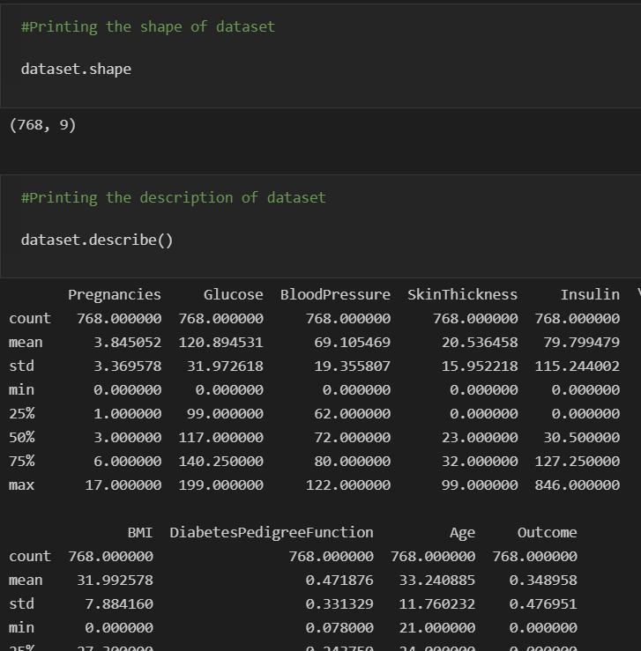
Data Exploration

Slide 15
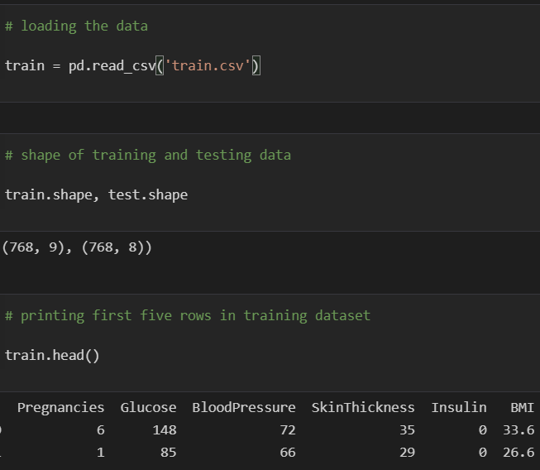
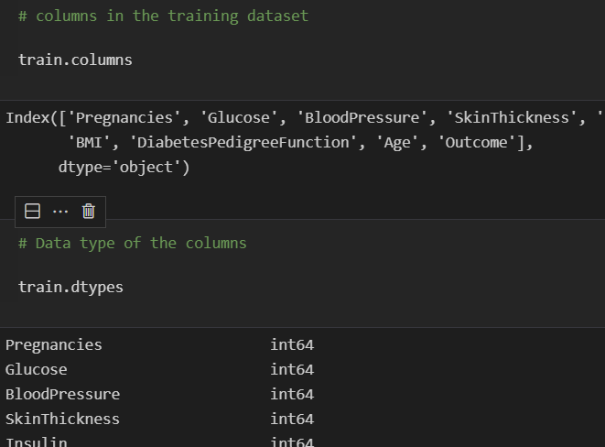
training data

Slide 16
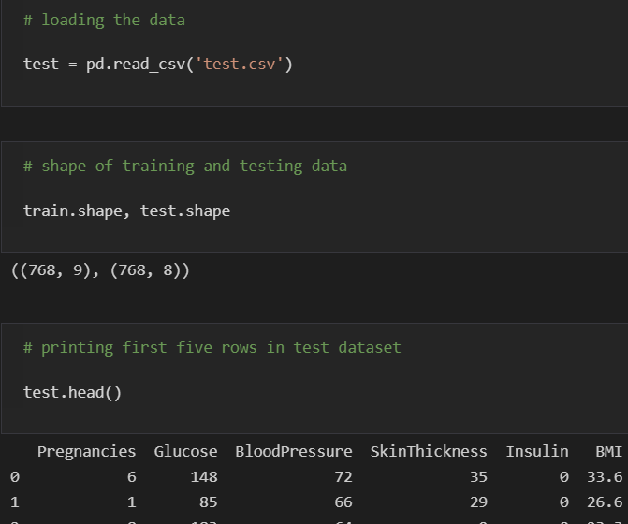
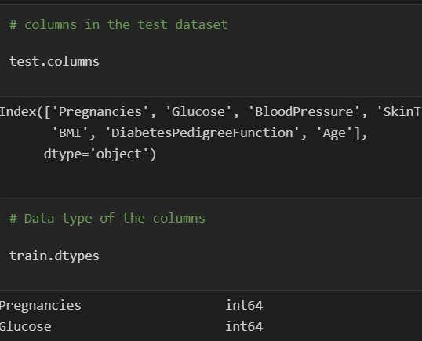
testing data

Slide 17
Analysis of data
I have analyse and visualize the dataset using analysis methods.
It includes two analysis methods-
1.Univariate analysis- Univariate analysis is the analysis of one (“uni”) variable.
2.Bivariate analysis- Bivariate analysis is the analysis of exactly two variables.

Slide 18
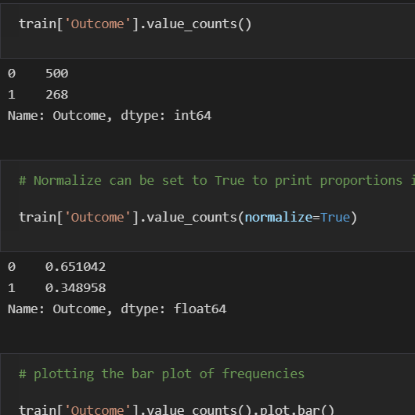
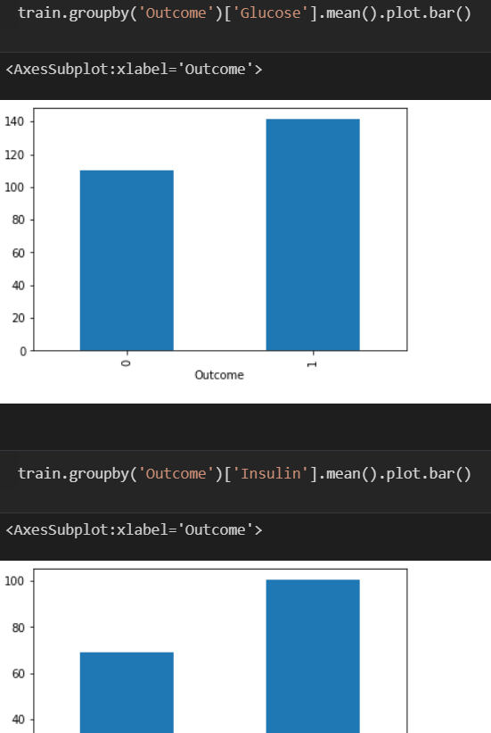
Univariate analysis

Slide 19
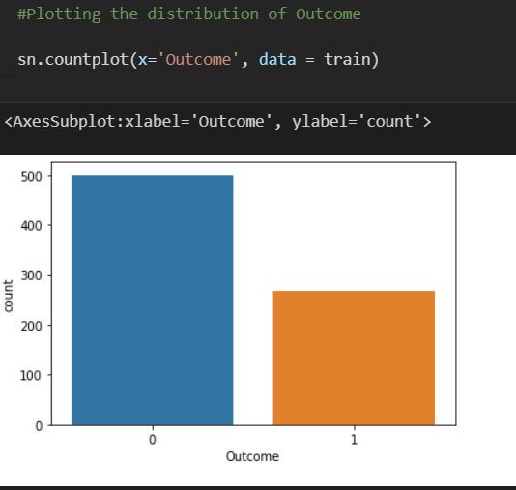
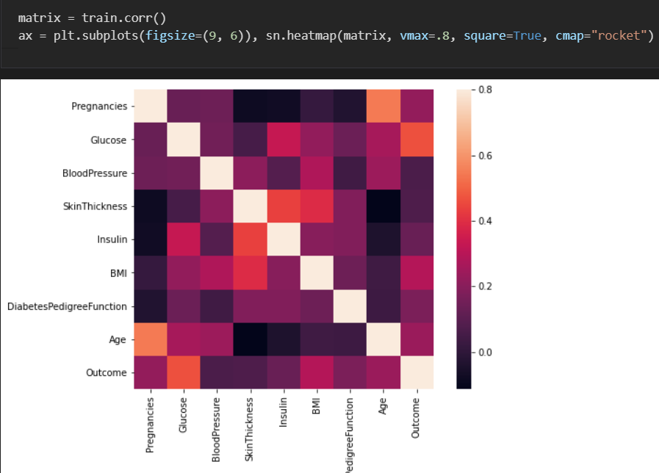
bivariate analysis

Slide 20
Model building
Model Selection-
The extracted features are fed into different classifiers to select the best model.
Classification-
Classification is the process of identifying an observation belongs to which set of categories

Slide 21
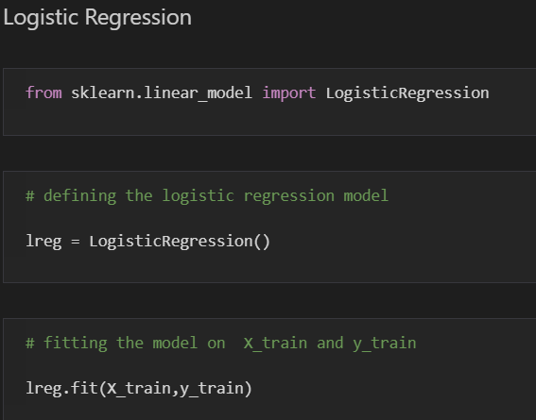
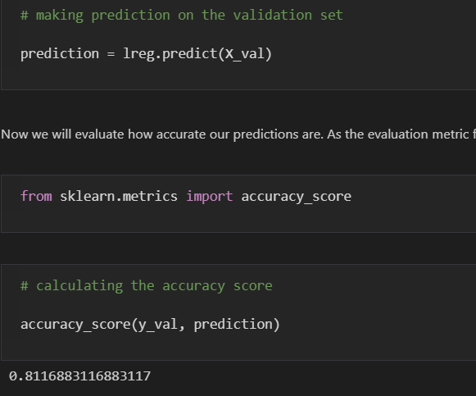
LOgistic regression

Slide 22
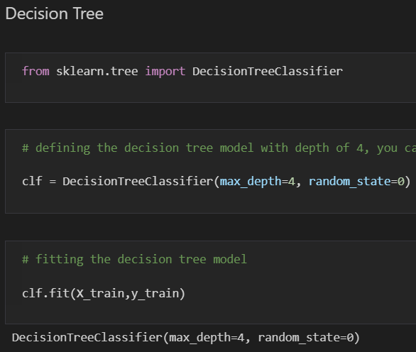
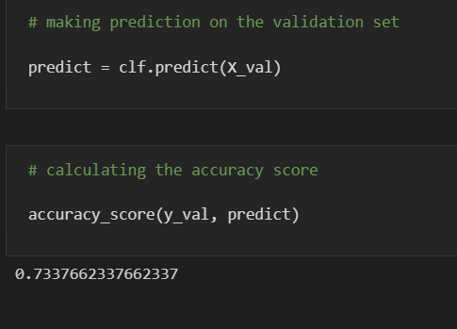
Decision tree

Slide 23
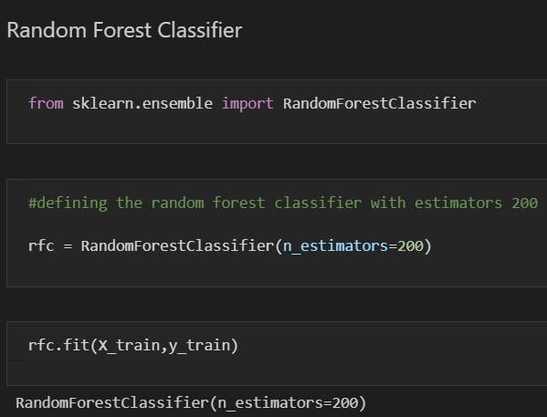
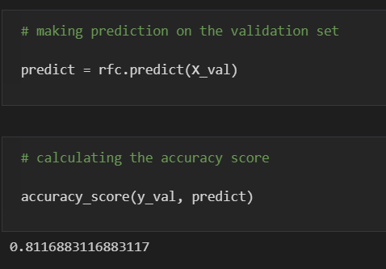
Random forest

Slide 24
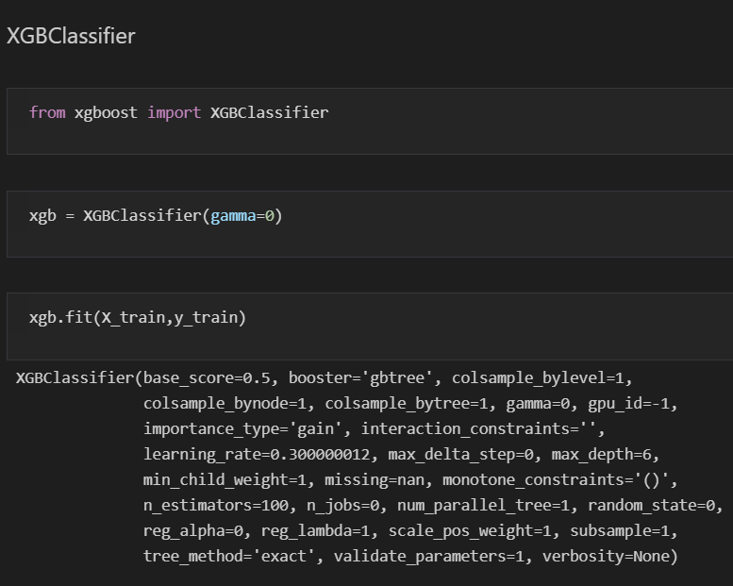
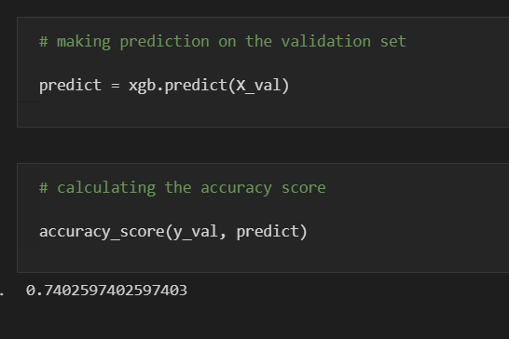
Xgboost classifier

Slide 25
Final model selection
On the basis of the accuracy we basically finalize the model and select the best model .
Here we have selected the logistic regression model as it giving the best accuracy of 81%.
The logistic regression model providing more accuracy then any other model

Slide 26
Conclusion
I have analysis that the early prediction of diabetes by taking all the related factors in its tests and implementing using data science techniques by extracting knowledge from our real health care medical dataset to predict diabetic patients thus we have done our experiment using some of the various data science algorithms namely Random forest, decision tree, logistic regression, to predict dataset. The main aim of this project was to design and implement diabetes prediction using data science and performance analysis of the methods and it has been achieved successfully. The proposed approach uses various classification and ensemble learning method in which LOGISTIC REGRESSION, RANDOM FOREST, DECSION TREE and LOGISTIC REGRESSION.

Slide 27
reference
https://www.kaggle.com/uciml/pima-indians-diabetes-database/data Pima Indians Diabetes Database Predict the onset of diabetes based on diagnostic measures.
https://www.healthline.com/health/history-type-1-diabetes Medically reviewed by Suzanne Falck, M.D., FACP — Written by Eloise Porter — Updated on September 18, 2018.
https://my.clevelandclinic.org/health/diseases/7104-diabetes-mellitus-an-overview Overview and Conditions of Diabetes and Diabetic patient.
https://pubmed.ncbi.nlm.nih.gov/26788261/ Milestones in the history of diabetes mellitus: The main contributors.Karamanou M, Protogerou A, Tsoucalas G, Androutsos G, Poulakou-Rebelakou E.World J Diabetes. 2016 Jan 10; 7(1):1-7.

Slide 28
Thank you

